Slide 1


EMERGENCY BUNKER
"Prepare for anything, with emergency bunker: Your refuge in uncertain times."

Slide 2
PROJECT OUTLINE
The Emergency Bunker project is an IoT-based system for monitoring and controlling an emergency bunker's functionalities. The system will include two primary modes: Safe Mode and Emergency Mode, along with a secure electric box to manage power distribution and consumption.

Slide 3
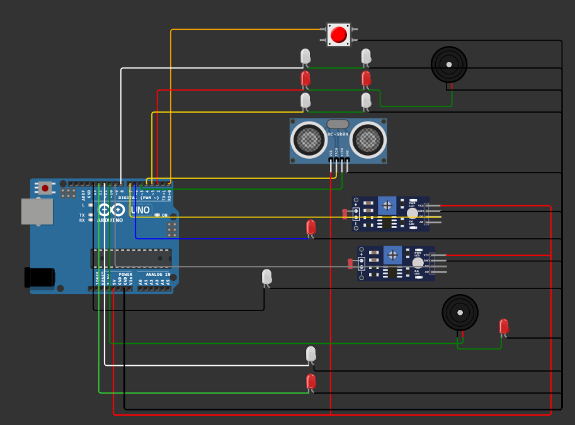
CIRCUIT

Slide 4
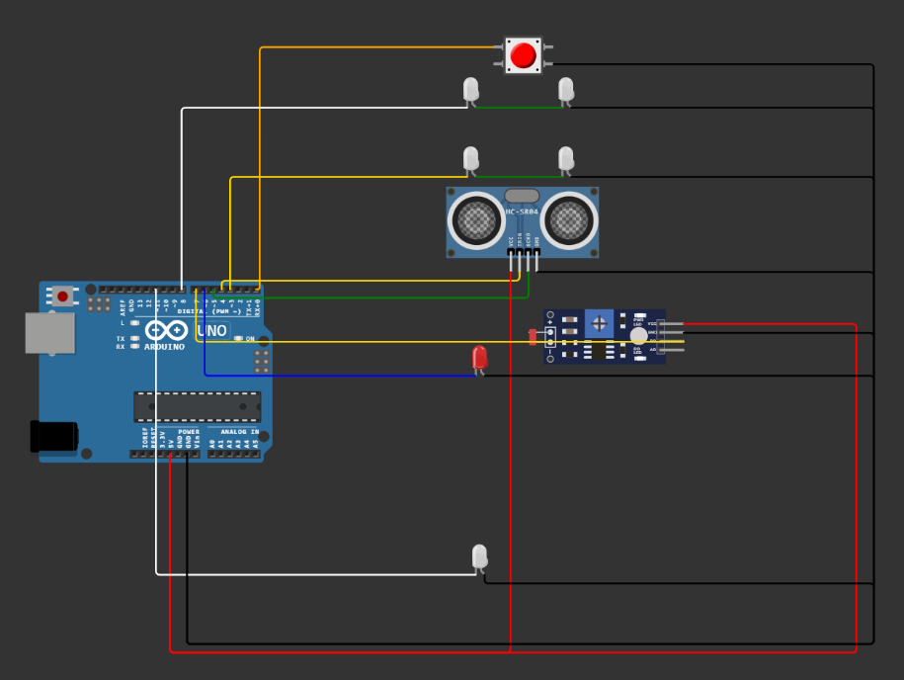
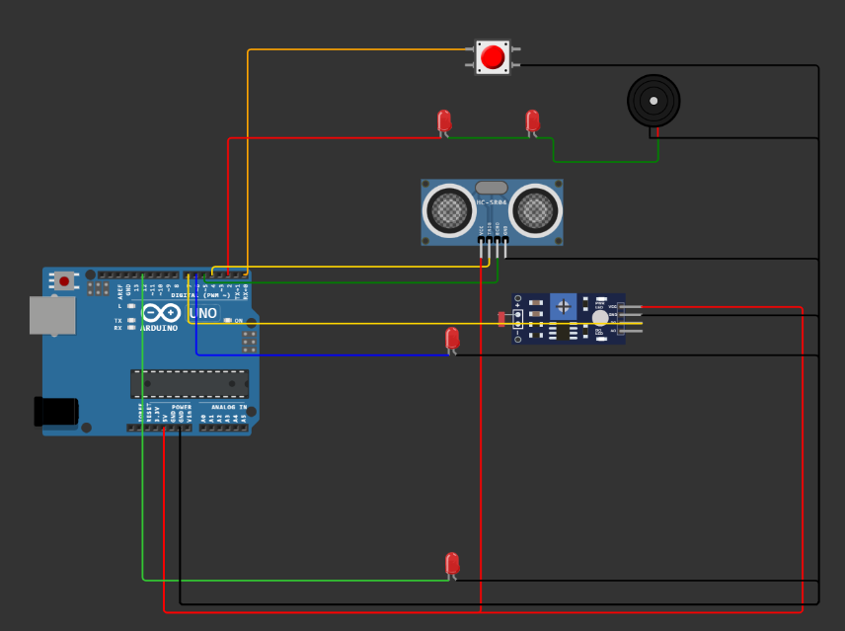
Safe Mode Circuit
Emergency Mode Circuit

Slide 5
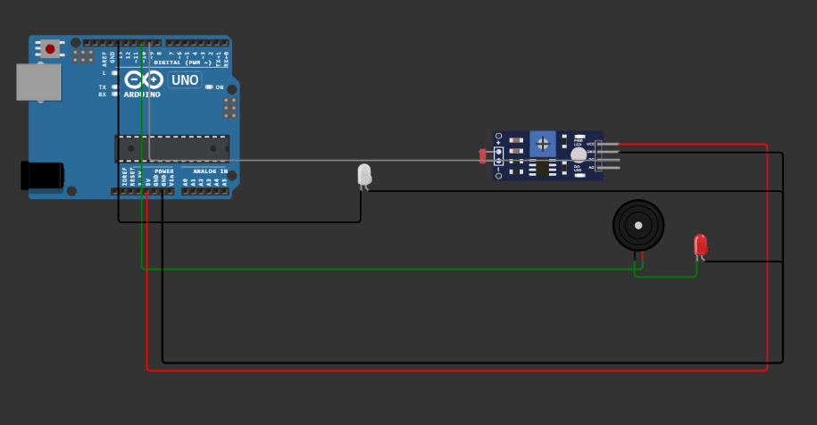
ELECTRIC BOX CIRCUIT

Slide 6
PROJECT SCOPE
1. Safety Features: we can integrate additional sensors such as temperature, smoke detectors, and motion sensors to enhance safety measures in the bunker.
2. Remote Monitoring and Control: Implement remote monitoring and control capabilities allowing users to monitor bunker conditions and control various parameters remotely through a smartphone or computer.

